Slide 1
SDTM Specification Training
Company Confidential © 2014 Eli Lilly and Company

Slide 2
Training Goals
Understand the high level steps of the SDTM specification process
Understand how to configure an SDTM Study Specification Template (SST) to make it study specific
Understand how the Trial Design Domain template and Timepoint spreadsheet fit into the SDTM specification process
Know what and where your resources are
This training assumes attendees have a basic understanding of SDTM (Domains, Variables)

Slide 3
Connecting Lilly’s Data Collection Standards to the SDTM Specifications

Slide 4
Data element Definitions (DEDs)

Slide 5
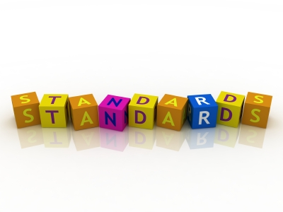
Data Element Definitions (DEDs) Overview
What are Data Element Definitions?
The Data Collection Standards
The “menu” of standard options for building CRFs for a study
The DEDs have been developed in alignment with the CDASH conformance rules
The Lilly Data Element Definition library is based on the CDISC (Clinical Data Interchange Standards Consortium) ODM (Operational Data Model) concept of Forms, Item Groups, Items, and Code Lists.
What are the collection standard levels?
Core, TA, and Study Level Definition (SLD)

Slide 6
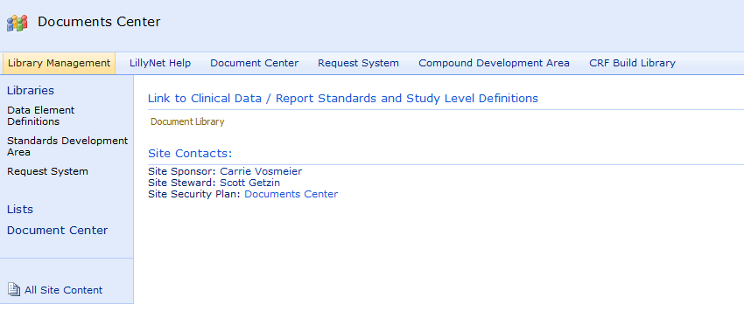
Where are the DEDs?
The DEDs are stored in the Document Center:
http://lillynetcollaboration.global.lilly.com/sites/GCDMLibraryManagementTeam/Documents/default.aspx

Slide 7
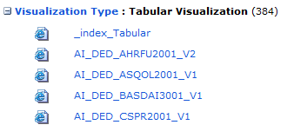



How do I know if a DED is Core, TA or SLD?
The designation of a DED as CORE, TA, or SLD is indicated in the naming of the DED:
DED Library

Slide 8
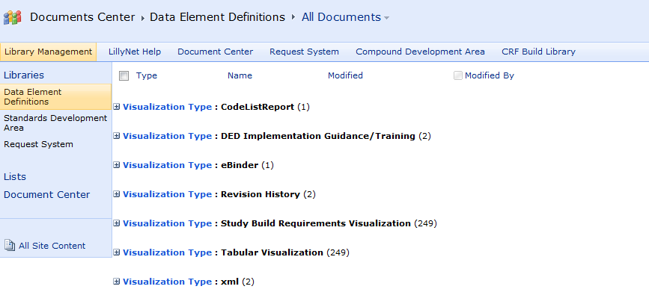
DED Visualization Types
There are several options for viewing DEDs
Study Build Requirements Visualization
Tabular Visualization

Slide 9
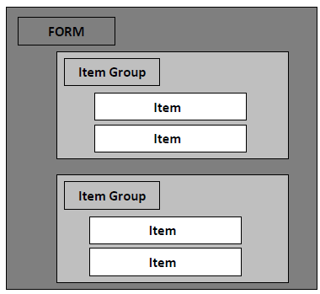
Tabular Visualization Summary
The Tabular Visualization displays all of the Item Groups, Items, and Codelists and their associated attributes and business rules.
This visualization presents all attributes in a hierarchical format.
There may be multiple Item Groups associated to one Form.
An Item Group may contain one or more items.

Slide 10
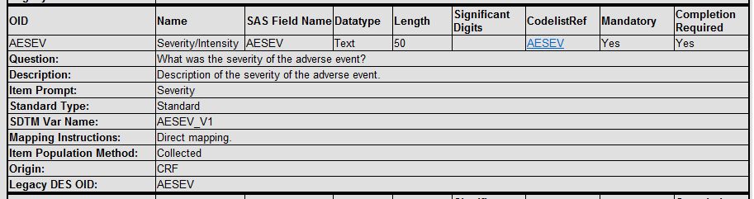
DED – Item Level Attributes
Key information contained at the Item Level:
Key
Mandatory – “Yes” means the item must be present in the observed data set
Completion Required – “Yes” indicates an item must be prepopulated or answered
Question Text / Item Prompt – text expected to appear on the CRF
SDTM Variable Name and Mapping Instructions
Valid Responses – included in the associated Code List Reference

Slide 11
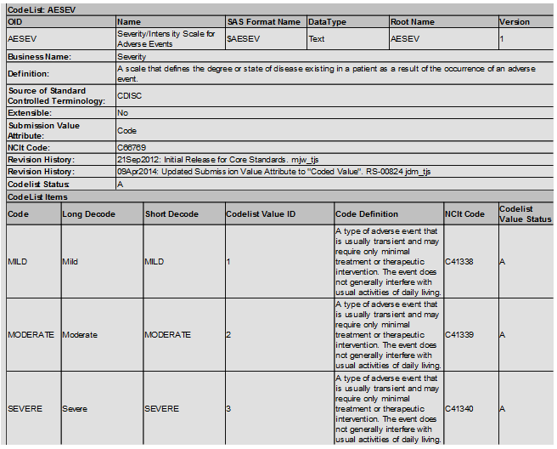
DED – Codelist Attributes
Codelists
Defines the attributes that apply to the codelist and responses.

Slide 12
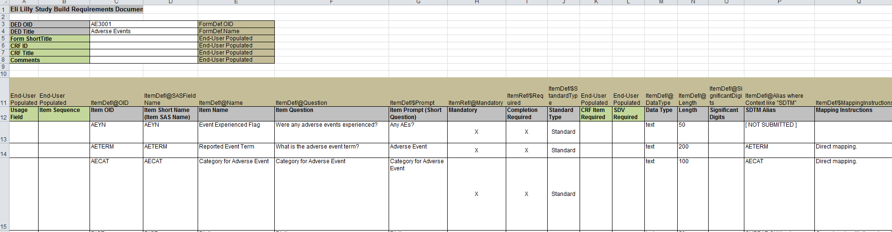
Study Build Requirements Visualization Summary
Provides view of DED metadata in spreadsheet format

Slide 13

Want to learn more?
Reminder: The DEDs are stored on the following collaboration site:
http://lillynetcollaboration.global.lilly.com/sites/GCDMLibraryManagementTeam/Documents/Data%20Element%20Definitions/Forms/AllItems.aspx
For more detailed information about DEDs please refer to the Lilly DED Implementation Guidelines which are also located on the above collaboration site under Visualization Type: DED Implementation Guidance/Training.

Slide 14
Relationship between deds and crfs

Slide 15

DED and CRF Relationships
In the CRF string the corresponding DED appears as part of the Form RefName
(Note: A RefName is simply an internal reference identifier for an InForm object).
This indicates the DED which was used to create the CRF. The example below shows that the AE3001 DED was used to create this Adverse Events CRF.

Slide 16

DED and CRF Relationships
Both the CRF string and DED can be used to help determine the corresponding SDTM variable for collected data.
In the example below, the first part of the Item RefName for the question “What was the severity of the adverse event?” corresponds to the variable (or Object Identifier – OID) in the DED:

Slide 17
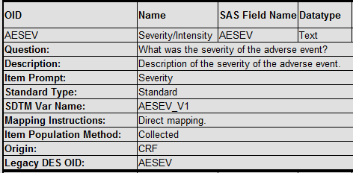
DED and CRF Relationships
Locate the variable in the DED where the OID matches the Item RefName on the CRF. Note that the Question attribute in the DED matches the question that appears on the CRF. If the Question text from the DED is too long to fit on a CRF, then the Item Prompt text will be used.
The SDTM Var Name corresponds to the SDTM variable name in the SDTM domain:

Slide 18

Summary
The metadata from the DEDs is used:
To create the CRFs
Used by the programs that generate the SDTM SST
Be sure to reference the DEDs
often when configuring the SDTM specs

Slide 19
SDTM Specifications

Slide 20
SDTM Programming Specifications
Consists of 3 Components:
1. SDTM Study Specifications from the Study Specification Template (SST) Configuration Process
2. Trial Design Model (TDM) Template
3. Time Point (TPT) Spreadsheet
6/21/2016
Company Confidential © 2014 Eli Lilly and Company
20

Slide 21
SDTM Study Specifications
The completed SDTM Study Specifications provide:
Programming Instructions
A clear set of instructions (algorithms) for programmers to ensure SDTM data sets follow the Lilly Data Standards
A format that enables compliance checks
Specifications can be checked to ensure that no potential errors or issues were introduced when configured for the study
Content needed for submission documentation
Complete documentation for the define.xml document for regulatory submission (including controlled terminology (CT) and value level (VL) metadata)
In short, the study spec is not just used for programming SDTM, but the eventual generation of the define.xml

Slide 22
Study Milestones and SDTM Specifications
Key Milestones
Protocol approval
Draft CRF string
CIS Mapping (4-6 weeks prior to FPV)
FPV
Protocol worksheet
Some data available for code validation soon after
Risky to start specs
Ok to start TDM and TPT spreadsheets
CRF string agreement
Risky to start SST process
Can map to domains and request SST
Data series summary table available to check configured SST against
Why?
Impacts the timing of SDTM spec development
Study team members can inform at what point the study is

Slide 23
Breaking it down…
Spec Writing
Now let’s take this part of the process and drill down into the details of developing/writing the SDTM specifications package…

Slide 24
Overview of SDTM Study Specification Process Steps
Spec Writing
SDTM Spec Package Development
(3 Parts)
Who?
Lilly
Lilly
TPO and Lilly
TPO and Lilly
Request and Generate SST
SDTM Standard Domains
Spec Review & Compliance Checking
What?
Configure the SST
SDTM Spec Finalization
Lilly or TPO*
Populate TDM Domains
Lilly or TPO*
Ready for SDTM Programming!
Populate TPT
Spreadset
*Depends on if the SDTM spec writing and programming work is internal or externally sourced
Lilly or TPO*
Company Confidential © 2012 Eli Lilly and Company

Slide 25
Definitions Along the Process
Standard Domain Templates
Generate SST
Configure
Study Specs
Compliance Checks
Standard Domain Template: The defined metadata for one SDTM dataset (Domain) maintained in the Lilly Document Center.
SST: The SST (Study Specification Template) is an excel spreadsheet that consists of Standard domain Templates and the metadata, including controlled terminology and sponsor defined controlled terminology needed and variables for the creation of all SDTM domains (datasets). There may be one or more SSTs for a study.
Generate SST: Automated process (currently CDI) that combines standard SDTM domain templates (excel file) into one spreadsheet with multiple tabs, one for each domain.
Configure SST: The SST is configured to define and/or subset the initially generated template (SST) to the study specific requirements.
Compliance Checks: Automated checks on the configured SST metadata to ensure compliance to the SDTM requirements.
Study Specifications: The final documentation (along with the Trial Design Domains and Timepoint Spreadsheet) for programmers to create the SDTM domains for the study.

Slide 26


SDTM Study Spec Package
What is the purpose?
Who develops it?
It is the programming specifications for writing the SDTM programs which will be applied to the raw data to be transformed into SDTM structured datasets
Define.xml for submission
SDTM Spec Writer/Programmer*
Might be an internal Lilly role (i.e. Stat Analyst)
Or an external role at a DSS or GSS TPO
SDTM Consultant and CDA consult as needed
Spec Writing

Slide 27
SDTM Study Specification Deliverables
Task
Generate SST
Configure Study Spec
Deliverable
SDTM Study Specification
Spec Template (Standard SDTM Domain templates pulled together in 1 Excel document)
Standard Domain Templates
Generate SST
Configure
Study Specs
Compliance Checks
Note: The SDTM Study Specification process can be executed more than once by batching completed Domains.
This is done for efficiency to allow SDTM programming to begin.

Slide 28
Each Process Step Explained
SDTM Standard Domains
Are located in the Document Center:
http://lillynetcollaboration.global.lilly.com/sites/GCDMLibraryManagementTeam/Documents/Document%20Library/Forms/Topic.aspx
SDTM Standard
Domains
Request and Generate the SST
SDTM Spec Package Development
Spec Review and Compliance Checking
Study Spec Finalization
Who?
Lilly Data Standards Group (SDTM/ADaM/TFLs)
Company Confidential © 2012 Eli Lilly and Company

Slide 29
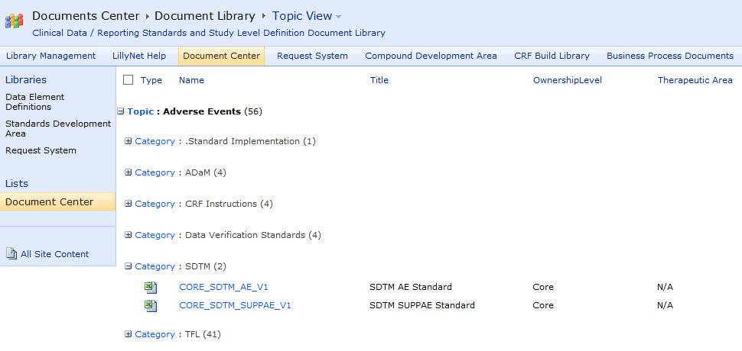
SDTM Standard Domain Templates Overview
Approved, published Domains by topic are stored in the Document Center:
Company Confidential © 2012 Eli Lilly and Company

Slide 30

Each Process Step Explained
SDTM Standard Domains
Request and Generate the SST
SDTM Spec Package Develop-ment
Spec Review and Compliance Checking
Study Spec Finalization
Request and Generate the SST (The SDTM Consultant)
Individual SDTM Domain Standards are pulled together into one excel document to create the SST
The SDTM Consultant selects the domains for the study (based on study team agreement for analysis and first data deliverable needs)
The SDTM Consultant completes the SST Generation Request Form
The CDI Administrator at Lilly generates the SST using CDI
Notes:
Add process documentation links

Slide 31
Request and Generate the SST
Before the request is submitted:
Prior to requesting the SST, the SDTM Consultant should ensure:
CRF string agreement has been achieved
Agreement has been obtained with the study team on the list of SDTM Domains to request for the first SST
CT_VL library has been updated and refreshed in SDD
Domains needed for the study are published in the Document Center
Request and Generate the SST

Slide 32
SST Batching
The SDTM Study Specification Template (SST) process can be executed more than once by batching Core and/or TA Domains.
This is done for efficiency to allow SDTM programming to begin while other Domains are being created if needed.
This means it is possible to have more than one SST document (eg, SST1, SST2, SST3, etc)

Slide 33
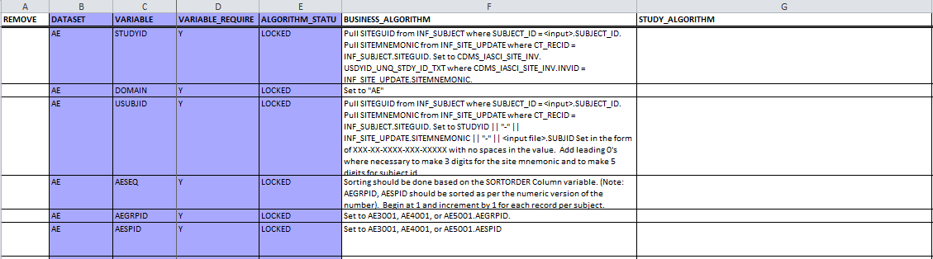
SDTM SST Example – Generated from CDI
Highlighted Columns)/”Locked” columns indicate un-editable fields
White columns within each domain tab are to be configured for the study by the SDTM Spec Developer
Tabs include: SELECT_TERMINOLOGY, DEFINE_TERMINOLOGY, TABLES, VALUES, and one for each SDTM Domain
Link to Sample SST

Slide 34
Each Process Step Explained
Standard Domain Templates
Request and Generate SST
Configure the SST
Study Spec Finalization
Spec Review and Compliance Checking
Configure
STUDY SPECIFICATION
Company Confidential © 2012 Eli Lilly and Company

Slide 35
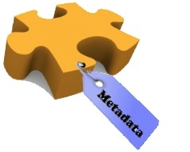
Configuring a SDTM Study Spec (From the Generated SST)
“Configuring”
Means you are selecting the Datasets, Variables, and Controlled Terminology applicable for the study
The selection is for what is NOT needed for the study
Place a “Y” in the REMOVE column to exclude a variable from a domain
Configuring makes your specifications specific for your study!
Metadata to Configure:
Variable Level
Can remove a Variable by REMOVE = “Y” if the Variable is not REQUIRED
Controlled Terminology (CT) – “Select” and “Define”
Can remove CT by REMOVE = “Y”
Can add CT at the study level (“Define”)
Link to Sample SST

Slide 36
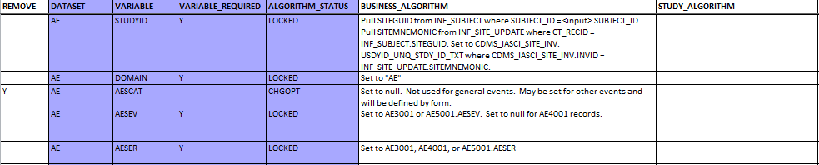
Removing Variables
Use the CRF string to assist with the configuration
For every SDTM domain, if VARIABLE_REQUIRED = “Y” in the SST, then this variable must be in the domain (there can’t be a “Y” in the REMOVE column)
Check the CRF string to determine if variables not indicated as “Required” will be collected. If a variable is found on the form, that variable CANNOT have a “Y” in the REMOVE column
If VARIABLE_REQUIRED is null in the SST and the variable is not found in the CRF string for the corresponding Domain, then the variable can be marked as “REMOVED” (put a “Y” in the REMOVE column).
Link to Sample SST

Slide 37
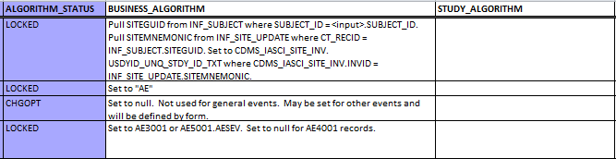
Adding Study Specific Algorithms
Examine the value in the “ALGORITHM_STATUS” column:
LOCKED
Leave both the business and study specific algorithm columns alone
Change only when there is a justifiable reason for adding study specific logic
Check with the SDTM Consultant to change “Locked” algorithms
CHGOPT (Change Optional)
If needed populate the “STUDY_ALGORITHM”
Not required to change if BUSINESS_ALGORITHM is applicable to study
CHGREQ (Change Required)
The “STUDY_ALGORITHM” must be populated
Add the appropriate “STUDY_ALGORITHM” in the field for the corresponding variables
The BUSINESS_ALGORITHM must remain for reference to the standard
Do not modify or delete the BUSINESS_ALGORITHM

Slide 38
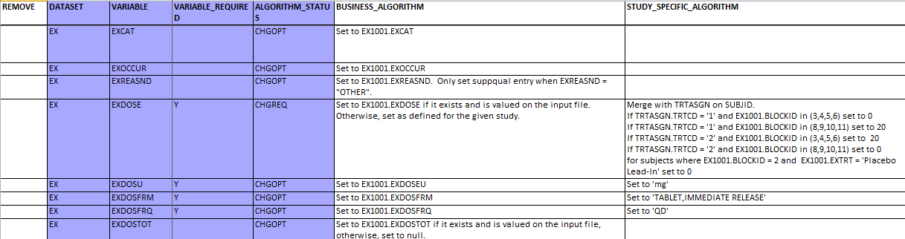
Study Specific Algorithm Example – EX Domain
Algorithm_Status = CHGOPT (Change Optional)
An Algorithm_Status of “CHGOPT” indicates a change to the algorithm may be made if needed for the study
For example, if not collected on a form, the “dose” associated variables such as units, form and frequency would need to be set by the spec writer (in the study specific algorithm column) to the units, form and frequency for the particular study
May refer to the protocol to obtain this information
May refer to the DED form to get controlled terminology
Company Confidential © 2012 Eli Lilly and Company

Slide 39

Study Specific Algorithm Example - EX Domain (continued)
Algorithm_Status = CHGREQ (Change Required)
Notice in the example below, a Study Specific Algorithm was added since the algorithm status is “Changed Required”
However, the BUSINESS_ALGORITHM was NOT deleted
The original Business Algorithm needs to remain in the SST for reference

Slide 40
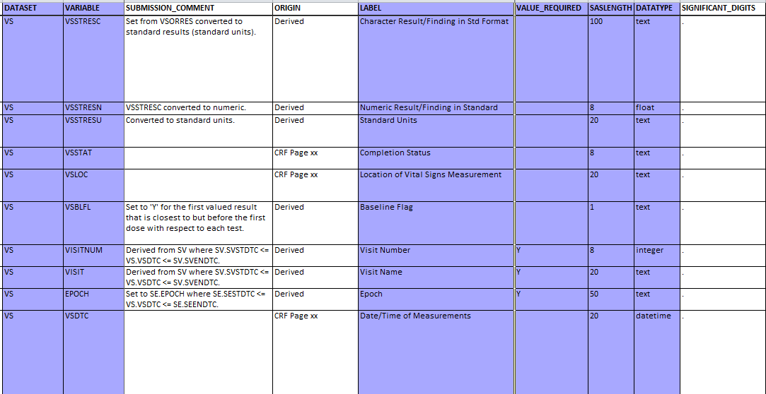
Other Columns in a Domain Tab
Submission Comment
Origin
Significant Digits
Do nothing - will be populated programmatically on the back end based on the study data

Slide 41
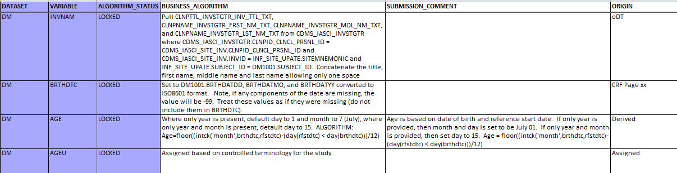
SUBMISSION_COMMENT Column
Needed for the define.xml document
The SUBMISSION_COMMENT field for a Variable must be populated if “ORIGIN” = “Derived”
It explains how the Variable’s value was derived since it is not collected on the CRF (e.g. an explanation of a calculation in layman’s terms as in the “AGE” Variable example below from the DM Domain)

Slide 42
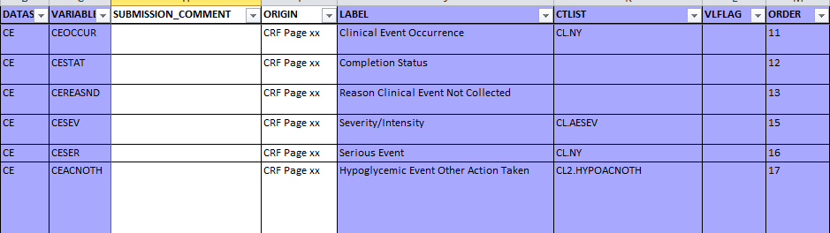
Populating the ORIGIN Column
If Origin is “CRF” page numbers are populated from the FINAL version of the SDTM Annotated CRF that is part of the final CRT Package
The corresponding CRF page numbers are documented to fulfill the requirement for the define.xml document
For each Variable that has an origin of “CRF” AND is not flagged for removal (i.e. “REMOVE = Y), populate the correct CRF page number(s)
Update the CRF Page number(s) by replacing the “xx” with the actual page number(s) where the variable is located
Company Confidential © 2012 Eli Lilly and Company

Slide 43
CONTROLLED TERMINOLOGY
Configure the SST

Slide 44
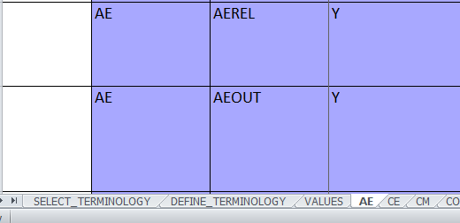
Controlled Terminology
Two Types
SELECT
DEFINE
The configured SST also contains metadata for Controlled Terminology:
Link to Sample SST

Slide 45
Select terminology
Configure the SST
Company Confidential © 2012 Eli Lilly and Company

Slide 46
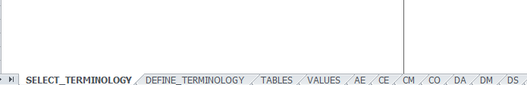
The “SELECT_ TERMINOLOGY” Tab
When the SST is initially generated:
The SELECT_TERMINOLOGY tab contains all possible values from all codelists in Lilly’s data collection standards.
Configuring the SELECT_TERMINOLOGY tab involves identifying and selecting the controlled terminology that is applicable to your study.
Link to Sample SST
Company Confidential © 2012 Eli Lilly and Company
Notes:
Don’t bother to subset Labs
New ones that were out of sync with DED changes need to be added in the DEFINE

Slide 47
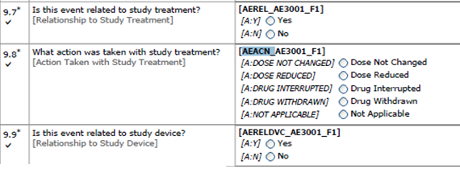
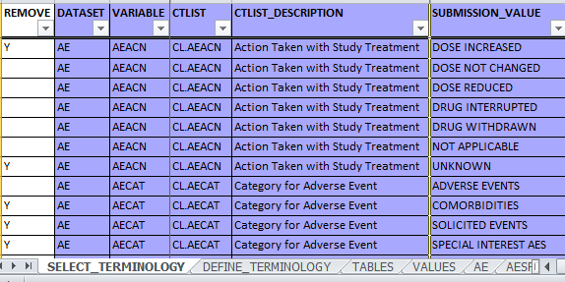
Configuring the “SELECT_ TERMINOLOGY” Tab
Example
Link to Sample SST
All possible values for a Variable where a codelist has been pre-defined, will appear in the SELECT_TERMINOLOGY tab
If a SUBMISSION_VALUE is not used for a study it should be REMOVED
This is done in reference to the CRF string
Examine the AE variable example for AEACN
Company Confidential © 2012 Eli Lilly and Company
Notes:
Don’t bother to subset Labs
New ones that were out of sync with DED changes need to be added in the DEFINE

Slide 48
DEFINE terminology
Configure the SST
Company Confidential © 2012 Eli Lilly and Company

Slide 49
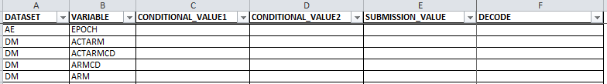
The “DEFINE_ TERMINOLOGY” Tab
When the SST is initially generated:
The DEFINE_TERMINOLOGY contains no entries or values.
Configuring the DEFINE_TERMINOLOGY tab involves identifying controlled terminology that is unique for your study and not defined by industry or Lilly data standards.
Link to Sample SST
Company Confidential © 2012 Eli Lilly and Company
Notes:
Don’t bother to subset Labs
New ones that were out of sync with DED changes need to be added in the DEFINE

Slide 50
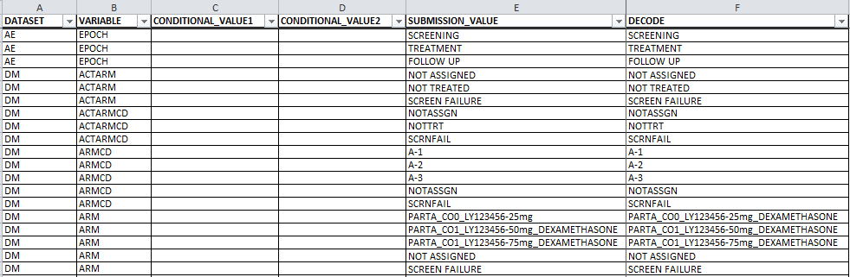
DEFINE_TERMINOLOGY Example
Some code lists need to be defined per protocol. These are typically study level terminology (e.g., ARM, ARMCD)
They are “defined” for each applicable Domain (AE and DM example below)
Add extra rows as needed
DECODE pertains to the SUBMISSION_VALUE being coded. Anything that is coded must be decoded (ie, what does this mean in English) for an agency reviewer in the define.xml
Link to Sample SST
Company Confidential © 2012 Eli Lilly and Company

Slide 51
DEFINE_ TERMINOLOGY Summary
The variables in the DEFINE_TERMINOLOGY tab are indicated in the Lilly SDTM standards as requiring definition at the study level.
The DEFINE_TERMINOLOGY (and SELECT_TERMINOLOGY) exist for the define.xml as well as reference to the study teams for programming SDTM datasets (i.e., it will not automatically show up in your data, but must be assigned).

Slide 52
Value level metadata
Configure the SST
Company Confidential © 2012 Eli Lilly and Company

Slide 53
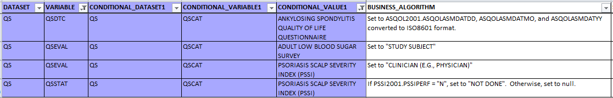
“VALUES” Tab Overview
Serves as a “lookup table” for SDTM Programmers to assist with populating SDTM variables
Shows the conditional values columns (these are “if then” statements)
Contains value level metadata for all Lilly standards
It does NOT need to be configured. Used as a reference only
Notice there is no “REMOVE” column – rows from the VALUES tab should not be deleted
Link to Sample SST

Slide 54
“VALUES” Tab
DO NOT add a “REMOVE” column to the VALUES tab. Values are strictly there for submission reference. No rows are to be removed.
DO NOT add a study specific algorithm.
If you are unsure about the VALUES tab, work with your SDTM Consultant.
VALUES for specific variables will only need to be changed in the rare case a sync issue occurs for CT/VL file updates compared to the time the SDTM SST was created.
Consult with your SDTM SME before altering anything in the VALUES tab.
Link to Sample SST

Slide 55
Compliance checks

Slide 56
Each Process Step Explained
Standard Domain Templates
Request and Generate SST
Configure the SST
Study Spec Finalization
Spec Review and Compliance Checking
Stat Analyst and/or SDTM Consultant reviews the configured SST
Spec developer reconciles any initial configuration issues noted
Spec compliance tool is executed against the configured SST
Company Confidential © 2012 Eli Lilly and Company

Slide 57
Spec Compliance Checks
Compliance checks are done to ensure the SST was configured correctly and has maintained adherence to the Lilly SDTM standards
A compliance check of the configured SST must be performed before SDTM programming can begin
Why:
Spec developer reviews and resolves issues
Who:
It is recommended to store the spec compliance reports with completed specifications
Where:

Slide 58
Each Process Step Explained
Standard Domain Templates
Request and Generate the SST
Configure the SST
Study Specs Finalized and Approved
Spec Review and Compliance Checking
*Note: Spec review and compliance checking is currently required for all versions of the SDTM specifications but only the specs for major PRD deliverables require formal approval such as eSignature in SDD.
Ready
for SDTM Programming!
Company Confidential © 2012 Eli Lilly and Company

Slide 59
SDTM Specifications: trial design MODEL (TDM) template timepoint (TPT) spreadsheet

Slide 60
SDTM Programming Specifications
Consists of 3 Components:
1. SDTM Study Specifications from the Study Specification Template (SST) Configuration Process
2. Trial Design Model (TDM) Template
3. Time Point (TPT) Spreadsheet
What are they?
How are they completed for Lilly studies?
6/21/2016
Company Confidential © 2014 Eli Lilly and Company
60

Slide 61
Trial Design model template

Slide 62
What is the Trial Design Model (TDM?)
The Trial Design Model defines a standard structure for representing the planned sequence of events and the treatment plan for the trial. It describes the treatment groups and planned visits and assessments that will be experienced by trial subjects.
The trial design domains do not contain subject-level data
Notes:
Add talking point to why #2 is true, need to define upfront, traceability, clarity, transparency fosters confidence in results.

Slide 63
Descriptions: TE, TA, TI, TS, TV
Trial Elements (TE): Elements are the time/activity segments or “building blocks” that collectively describe the conduct of the trial
Trial Arms (TA): Describes each planned Arm in the trial
Trial Visits (TV): Defines the visit schedule per the protocol (planned visits only)
Trial Inclusion (TI): Contains the Full list of Inclusion/ Exclusion criteria from protocol.
Trial Summary (TS): Contains key parameters descriptors of the trial

Slide 64

Trial Design Domains in SST
The SST provides the metadata (or structure) of the trial design domains:
The completed Trial Design Model (TDM) template provides the content or variable level data to populate the trial design domain datasets
SampleSST

Slide 65
Trial Design Model (TDM) Template
Completed as part of the SDTM specification process
Template for TDM provides a tab for each of the different trial designs domains including instructions and examples and a tab for each domain
Information needed for completing the TDM typically comes from:
Protocol, namely the Schedule of Events (SOE)
CRF String
Input from the study team
What is defined becomes the actual data in the trial design datasets
Trial design domains need to be defined upfront in order to populate the business algorithm for the SE and SV domains
TA, TV, TE need to be done upfront but TI and TS can be done later if necessary due to time constraints

Slide 66
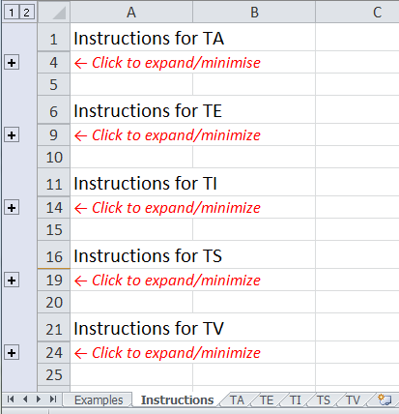
Blank TDM Template for SDTM Spec Development
Guidance for populating the template is located on the “Instructions” tab. There is one set of instructions for each of the 5 trial design domains
Click on the plus sign to expand each section of instructions
Once expanded, the instructions for each Variable for that Domain is displayed (TI Domain example below)
TDM

Slide 67
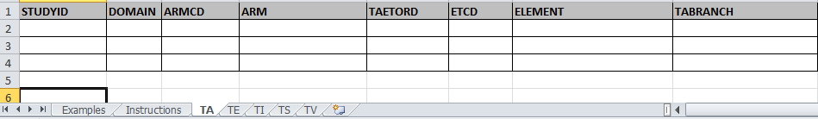

Where Do I Put the Trial Design Information for My Trial?
A blank tab with the appropriate variables exists for each Trial Design Domain within the template
This is where the study specific information relating to trial design gets populated
6/21/2016
Company Confidential © 2014 Eli Lilly and Company
67

Slide 68

Locating a Blank Trial Design Template in the Document Center
Business Document Repository
Business Document Repository > Data Analysis and Delivery > Specification Development > “Trial_Design_Domains”
TDM
Company Confidential © 2012 Eli Lilly and Company

Slide 69
Timepoint spreadsheet

Slide 70


SDTM Time Point Table (TPT)
Spreadsheet
What is it?
one component of the SDTM specifications; a separate excel spreadsheet
Why is it needed?
it serves as a lookup table to populate specific SDTM timing variables in the programming of SDTM datasets
e.g. LB, EG, QS, VS, PC are common Domains with timing variables
Company Confidential © 2012 Eli Lilly and Company

Slide 71
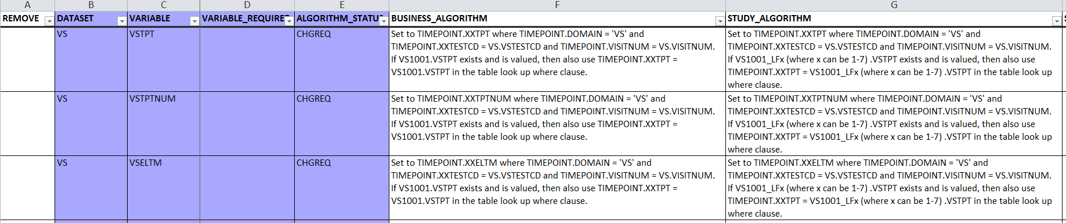
Timepoint Spreadsheet
Connection to SST
Defines specific SDTM timing variables:
xxTPT – Planned Time Point Name
xxTPTNUM – Planned Time Point Number
xxELTM – Planned Elapsed Time from Time Point Reference
xxTPTREF – Time Point Reference
xxRFDTC – Date/Time of Reference Time Point
SampleSST
Notes:
Add talking point to why #2 is true, need to define upfront, traceability, clarity, transparency fosters confidence in results.

Slide 72

Time Point Spreadsheet
Depending on the study design, populating the TPT requires input from:
SDTM Consultant, CDA, CLO,and PK representatives
It is populated according to the protocol design using the Schedule of Events (SOE)
Who Populates It?
Typically the Spec Writer at Lilly or the TPO
Company Confidential © 2012 Eli Lilly and Company
Notes:
Add talking point to why #2 is true, need to define upfront, traceability, clarity, transparency fosters confidence in results.

Slide 73
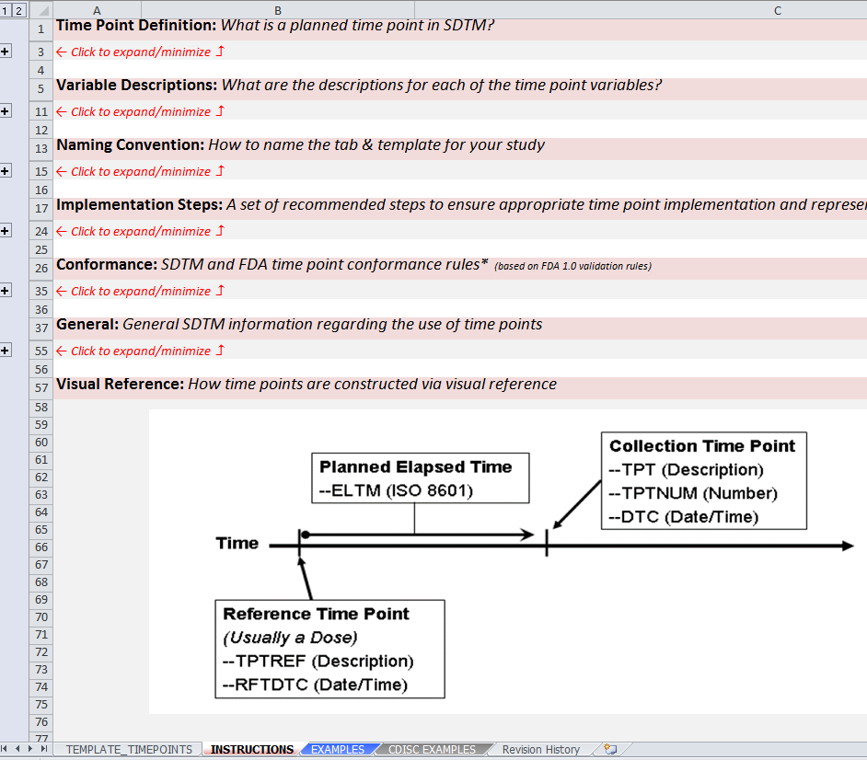
Time Point Spreadsheet
Guidance for populating the template is located on the “Instructions” tab.
Different scenarios to assist with completion of the spreadsheet are provided on the “Examples” tab.
The study specific timepoint information is entered into the “Template_Timepoints” tab.
TPT
Notes:
Add talking point to why #2 is true, need to define upfront, traceability, clarity, transparency fosters confidence in results.

Slide 74
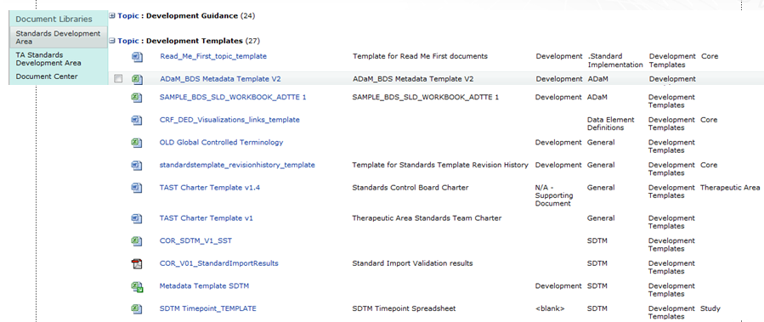

Locating a Blank TPT Spreadsheet from the Document Center
Business Document Repository
Business Document Repository > Data Analysis and Delivery > Specification Development > “Time_Point_Template”
TPT

Slide 75
Summary

Slide 76




SDTM Spec Development Summary
The complete SDTM Specification Package includes:
Time Point Spreadsheet
Trial Design Domain Spreadsheet
Study specific configured SST (Study Specification Template)
Compliance checks are performed against the configured SST; no compliance checks for TDM and TPT spreadsheets
SDTM specs (incl TPT and TDM) are signed off
The SDTM Spec Developer facilitates the SDTM spec development process with input from the study team and in consultation with the Lilly SDTM Consultant
Contact the Lilly SDTM Consultant assigned to the study
for questions regarding Lilly process and complex trial designs
Notes:
Add talking point to why #2 is true, need to define upfront, traceability, clarity, transparency fosters confidence in results.

Slide 77
Helpful Links
Link to Document Center:
http://lillynetcollaboration.global.lilly.com/sites/GCDMLibraryManagementTeam/Documents/default.aspx
Link to Trial Design Template:
http://lillynetcollaboration.global.lilly.com/sites/CDFTProcess/Business%20Document%20Repository/Trial_Design_Domains.xlsx
Link to Timepoint Template:
http://lillynetcollaboration.global.lilly.com/sites/CDFTProcess/Business%20Document%20Repository/Time_Point_Template.xlsx

Slide 78

Questions ?

Slide 79
BACKUP SLIDES

Slide 80
SDTM Roles & Responsibilities by Sourcing Model
SDTM Owned by DSS (w/DSS SDTM vendor)
SDTM Owned by GSS (w/DSS SDTM vendor)
Action | CDA | Stat/SA | Sub. Consult. | SDTM Vendor | SDTM Consult.
Define SDTM mapping for new DEDs |  |  |  |  | A/R
Request SST (CDI) |  | C |  |  | A/R
Configure SST | A |  |  | R | C
SDTM spec compliance review | A | R¹ |  |  | R
Programming & validation of SDTM | A |  |  | R
SDTM dataset compliance report review (ex. OpenCDISC report) | A |  |  | R | R
SDTM domain review | A/R² | R¹ |  |  | R
CRT package creation (transport files, aCRFs, SDRG, define document) | A |  | C | R | C
CRT package review | A/R |  | C |  | R
Oversight of raw data deliverables | A/R | C |  |  | C
Oversight of SDTM deliverables | A |  |  |  | R
Overall Timeline & Vendor Management | A/R |  |  |  | C
Action | CDA | Stat/SA | Sub. Consult. | SDTM Vendor | SDTM Consult.
Define SDTM mapping for new DEDs |  |  |  |  | A/R
Request SST (CDI) |  | C |  |  | A/R
Configure SST |  | A |  | R | C
SDTM spec compliance review |  | A/R |  |  | R
Programming & validation of SDTM |  | A |  | R
SDTM dataset compliance report review (ex. OpenCDISC report) | I | A |  | R | R
SDTM domain review | C | A/R |  |  | R
CRT package creation (transport files, aCRFs, SDRG, define document) | C | A | C | R | C
CRT package review | I | A/R | C |  | R
Oversight of raw data deliverables | A/R | C |  |  | C
Oversight of SDTM deliverables* | C | A |  |  | R
Overall Timeline & Vendor Management* | A/R | C |  |  | C
* GSS is responsible for escalations with the SDTM vendor, but CDAs are responsible for other timeline & vendor management
¹ Should have reviewed but was a gap on most trials
² Does content review to ensure required raw data sources make it to SDTM. An end-to-end comparison, for a subset of patients, to ensure key data points in SDTM match those captured in the eDC system.

Slide 81
SDTM Roles & Responsibilities by Sourcing Model
SDTM Owned by GSS (w/GSS SDTM vendor)
SDTM Owned by GSS (in-house)
Action | CDA | Stat/SA | Sub. Consult. | SDTM Vendor | SDTM Consult.
Define SDTM mapping for new DEDs |  |  |  |  | A/R
Request SST (CDI) |  | C |  |  | A/R
Configure SST |  | A |  | R | C
SDTM spec compliance review |  | A |  | R | C
Programming & validation of SDTM |  | A |  | R
SDTM dataset compliance report review (ex. OpenCDISC report) | I | A |  | R | R
SDTM domain review | C | A/R
CRT package creation (transport files, aCRFs, SDRG, define document) | C | A | C | R
CRT package review |  | A/R | C |  | C
Oversight of raw data deliverables | A/R | C
Oversight of SDTM deliverables | I | A/R
Overall Timeline & Vendor Management |  | A/R |  |  | C
Action | CDA | Stat/SA | Sub. Consult. | SDTM Vendor | SDTM Consult.
Define SDTM mapping for new DEDs |  |  |  |  | A/R
Request SST (CDI) |  | C |  |  | A/R
Configure SST |  | A/R |  |  | C
SDTM spec compliance review |  | A/R |  |  | C
Programming & validation of SDTM |  | A/R
SDTM dataset compliance report review (ex. OpenCDISC report) | I | A/R |  |  | R
SDTM domain review | C | A/R
CRT package creation (transport files, aCRFs, SDRG, define document) | C | A/R | C
CRT package review |  | A/R | C |  | C
Oversight of raw data deliverables | A/R | C
Oversight of SDTM deliverables | I | A/R
Overall Timeline Management |  | A/R
N/A – No SDTM Vendor

